Slide 1

AI-Powered Marketing
Dynamic Pricing
Ernst Osinga

Slide 2

Pricing
Dynamic pricing
Data and algorithms
Legality and acceptance
Firm and consumer outcomes
Exercise
This Photo by Unknown Author is licensed under CC BY-SA

Slide 3

Today’s Goals
You should be able to:
  Define dynamic pricing
  Identify the data sources and algorithms that power dynamic pricing policies
  Evaluate the legal and ethical boundaries of dynamic pricing
  Discuss how "framing" changes consumer perception
  Explain welfare implications for firms and consumers
  Apply reinforcement-learning pricing logic in a simulation game

Slide 4
Literature
  Harvard Law Today
    The Algorithm Thinks You’re Rich… (Delta and dynamic pricing)
  Journal of Retailing
    Dynamic Pricing: Definition, Implications for Managers, and Future Research Directions
  American Prospect
    One Person, One Price
  Future of Privacy Forum
    The Price Is Right: Responsible Uses of Personal Data in Pricing
  Journal of Political Economy
    Personalized Pricing and Consumer Welfare
  Case
    Roast & Reward: An AI Reinforcement Learning Simulation Game

Slide 5

pricing

Slide 6




4Ps
Product
  Functionality
  Appearance
  Quality
  Packaging
  Brand
  Warranty
  Service / Support
Price
  List Price
  Discounts
  Allowances
  Financing
  Leasing Options
Place
  Channel Members
  Channel Motivation
  Channel Coverage
  Locations
  Logistics
  Service Levels
Promotion
  Advertising
  Personal Selling
  Public Relations
  Message
  Media
  Budget
Dynamic pricing
SEO/GEO
AI-Powered Advertising
Synthetic Market Research
(Virtual) Influencer Marketing

Slide 7
Price
Price directly affects revenue; promotion first generates a cost
Price-setting used to be at the individual customer level
  Pre-industrial haggling
“One price for everyone" was itself an innovation meant to build trust and simplify retail
We are now moving back toward individualized pricing, powered by data and algorithms

Slide 8
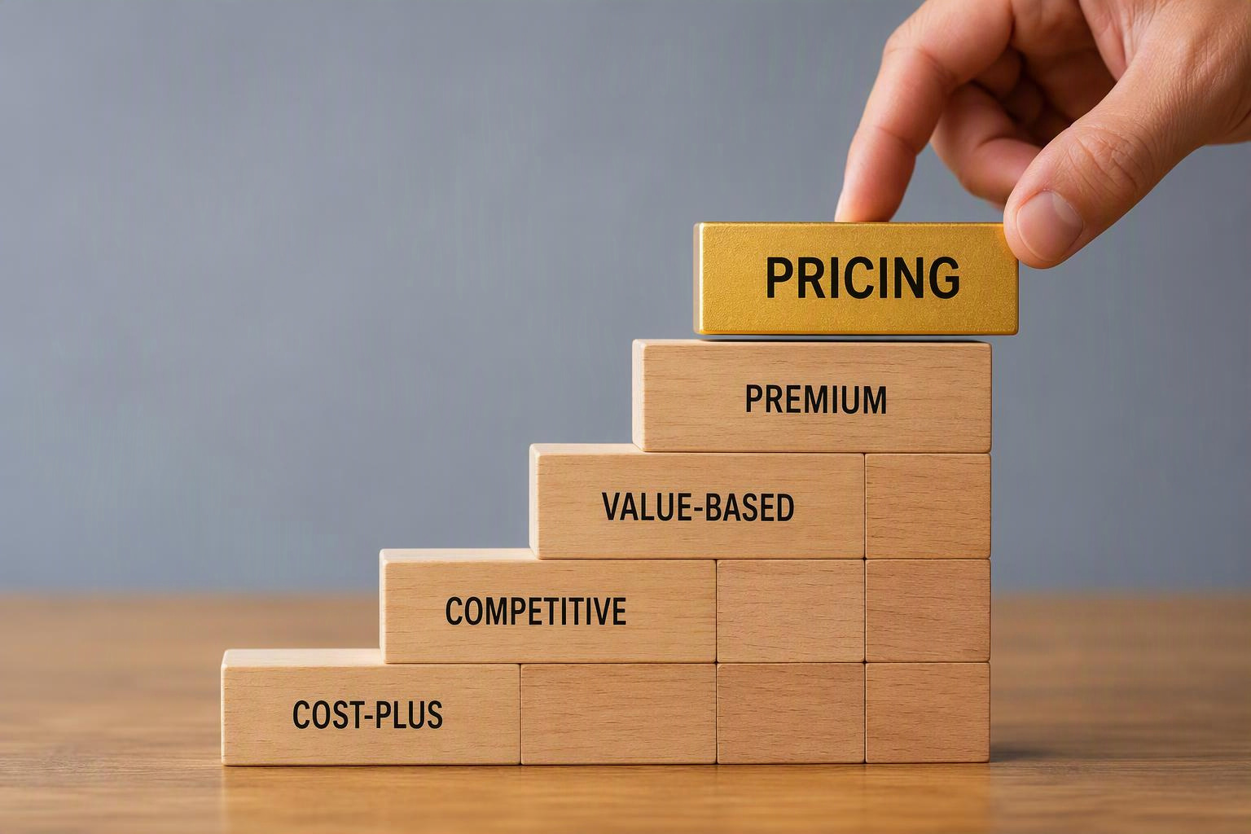
Pricing Strategies
Cost-plus pricing: mark up cost by a fixed margin
Competitive pricing: match or undercut rivals
Value-based pricing: charge based on perceived customer value
Price discrimination (economics): charge different prices to different segments

Slide 9

Developments
Prices are instantly changeable online
Firms have access to real-time customer browsing and purchasing data
A/B tests can be easily rolled out
New algorithms have emerged and increased computing power means that they can be implemented at large scale
This Photo by Unknown Author is licensed under CC BY-NC
Enter Dynamic Pricing

Slide 10
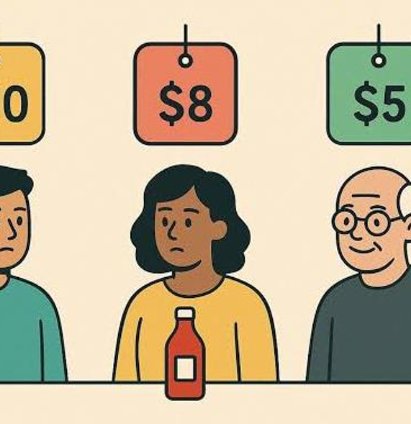
dynamic pricing

Slide 11
Dynamic Pricing
Price changes along 4 dimensions, the "4 Ps“ (Kopalle et al. 2023):
  People — individual consumers or segments
  Products — configurations/features/bundles
  Periods — time of day, season, demand cycle
  Places — geography/location/channel
Dynamic pricing as an umbrella term covering surge pricing, personalized pricing, markdown pricing, and geographic pricing
Also covers surveillance pricing, a more critical term to describe personalized pricing based on tracked behavioral/personal data
Not to be mistaken with the main 4 Ps!

Slide 12
Dynamic Pricing Ps
Dimension | Possible questions | Example
People | Does this customer have higher willingness-to-pay? | Loyalty-tier pricing, browsing history-based offers
Products | Does this configuration change value? | Bundled vs. à la carte airline fares
Periods | Is demand higher right now? | Surge pricing, hotel weekend rates
Places | Does location shift cost or value? | Regional grocery pricing, geo-based delivery fees

Slide 13

Why Firms Adopt Dynamic Pricing
Maximize revenues and/or profits by capturing more of each customer's willingness-to-pay
Efficient allocation of scarce inventory
Personalize the shopping experience; improve engagement
Competitive necessity

Slide 14
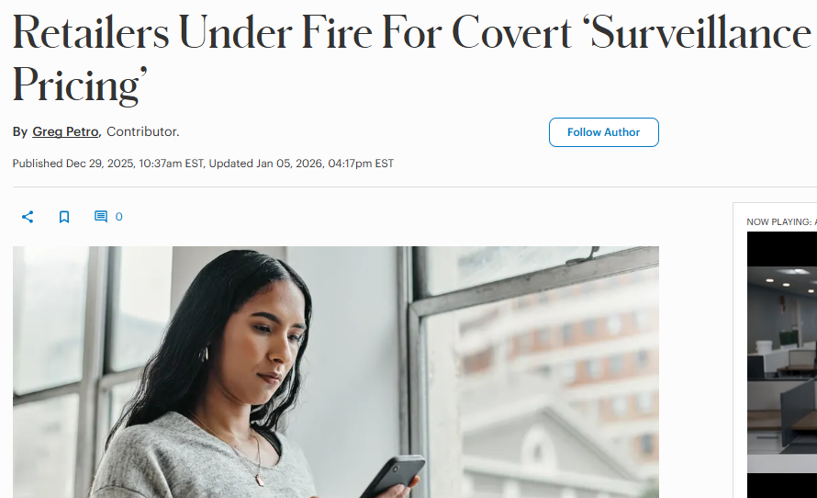
Downsides
Implementation complexity
Need for AI/data expertise
Consumer backlash risk
Potential legal exposure
Forbes.com
How much personalization is optimal — and defensible?

Slide 15
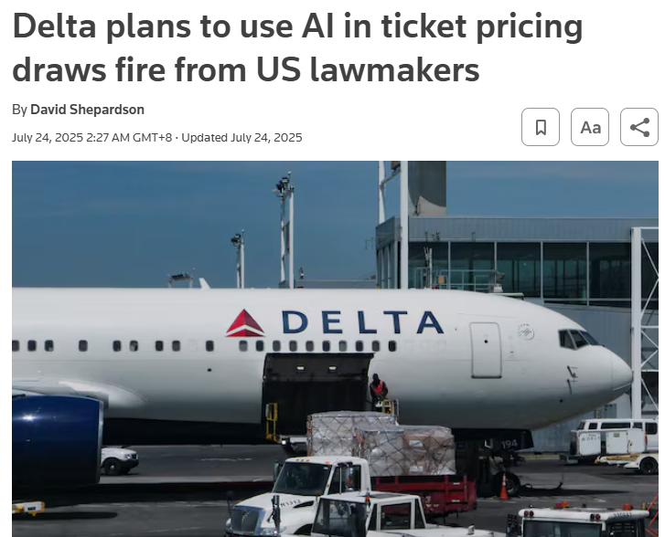
Delta
Delta said it plans to “deploy AI-based revenue management technology across 20% of its domestic network”, prompting public and lawmaker backlash
Delta later assured US lawmakers it would not set personalized fares
Reuters.com

Slide 16
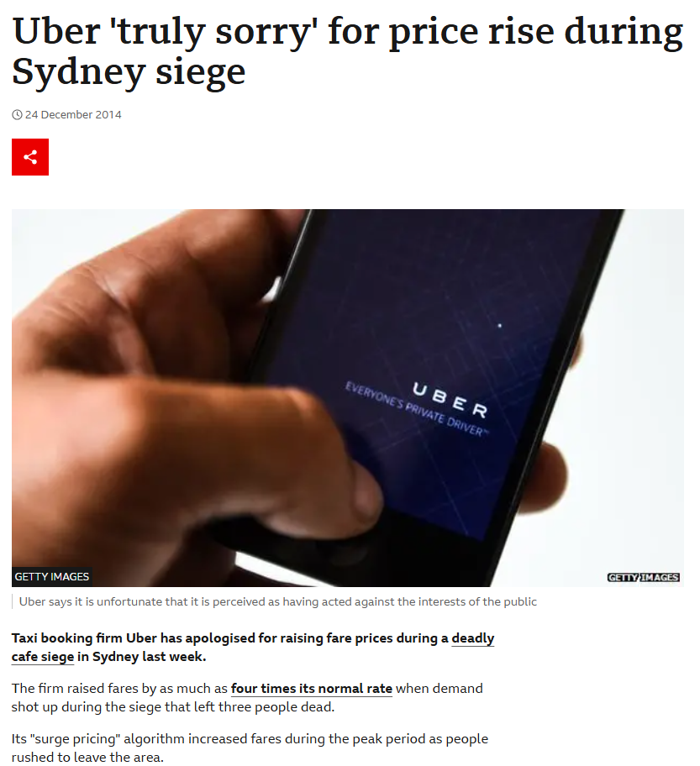
Uber
Uber prices rise algorithmically when demand for rides grows
Prices 4 times the normal rate during deadly cafe siege
"We didn't stop surge pricing immediately. This was the wrong decision. […] This [surge pricing] encourages more drivers to the area where people are requesting rides," when demand outstrips the supply of cars on the road, Uber said.
bbc.com

Slide 17
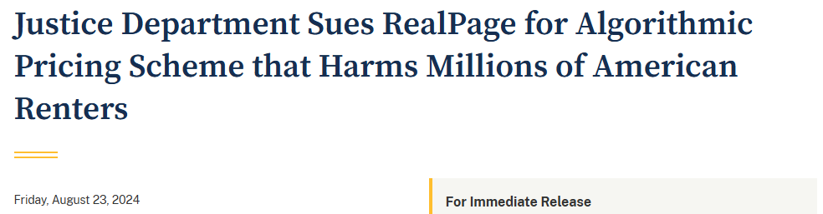
RealPage
The FTC and DOJ pursued RealPage, a software vendor whose algorithmic pricing tool allegedly enabled landlords to coordinate rent increases across a market
DOJ sued in 2024 alleging the pricing scheme harmed millions of American renters; a settlement followed later
justice.gov

Slide 18

data and algorithms

Slide 19

Data Sources
Own data
  Transactions, app/website behavior, loyalty accounts, customer service interactions
Data shared data through partnerships
  E.g., airline–hotel alliances
Data brokers
  Browsing, purchase, and demographic profiles across sites
This Photo by Unknown Author is licensed under CC BY

Slide 20
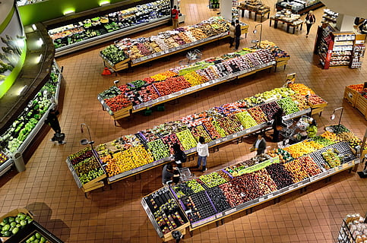
Data (Non-Personal)
Competitor prices (scraped or monitored in real time)
Inventory levels and supply constraints
Weather, local events, seasonality
Aggregate demand signals and time-of-day patterns
Possible applications
  Undercutting competitor prices
  Expiration-driven grocery discounts
  Holiday prices

Slide 21
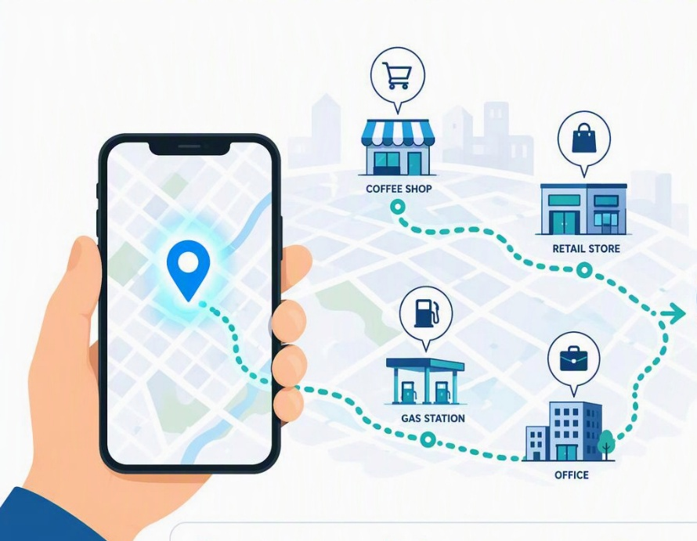
Data (Personal)
Purchase history and browsing behavior
  time spent on a page
  viewed items
  items in cart
Geolocation (device-level)
Loyalty program and account data
Device type, referral source
Demographic and inferred-interest data from data brokers
Growing focus on real-time data

Slide 22
From Heuristics to Machine Learning
Naïve approach
  Use simple heuristics
  E.g., "if inventory < X, raise price by Y%"
Machine learning
  Models that predict individual willingness-to-pay and optimal price points
  Machine learning
  Reinforcement learning
How do we dynamically set prices based on all these data points?

Slide 23
What Is Machine Learning?
Definition
Machine Learning (ML) is a subset of AI where systems learn patterns from data instead of being explicitly programmed
Core Idea
The system improves performance through:
Data
Experience
Feedback
Common Applications
Spam filtering
Image recognition
Demand forecasting
Customer segmentation

Slide 24
Reinforcement Learning
Definition
Reinforcement Learning (RL) is a type of machine learning where an agent learns by interacting with an environment and receiving rewards or penalties
Learning Process
Observe environment
Core Objective
Maximize long-term cumulative reward
Take action
Receive feedback
Improve future decisions

Slide 25
Term | Meaning
Agent | Decision-maker
Environment | World the agent interacts with
State | Current situation
Action | Choice made by the agent
Reward | Feedback signal
Policy | Strategy for selecting actions
Key Reinforcement Learning Concepts

Slide 26
Exploration
⬥ Trying new actions
⬥ Gathering information
⬥ Discovering better strategies
Exploitation
⬥ Using known successful actions
⬥ Maximizing immediate reward
⬥ Applying learned behaviour
A Fundamental RL Trade-Off
Real-World Example
A business testing new pricing strategies while continuing proven strategies

Slide 27
Sequential Decision-Making
Traditional ML
Each prediction is independent
Reinforcement Learning
Current decisions affect:
Future opportunities
Future rewards
Future states
Example
Allocating all delivery drivers to one busy area now may leave other regions understaffed later
Spending all the budget on early marketing may limit the ability to scale the product later
How is RL different?

Slide 28
Business Applications of RL
Retail & Pricing
Dynamic pricing
Inventory optimization
Finance
Portfolio optimization
Algorithmic trading
Operations
Supply chain optimization
Scheduling systems
Customer Experience
Personalized recommendations
Advertising optimization

Slide 29

legality and acceptance

Slide 30
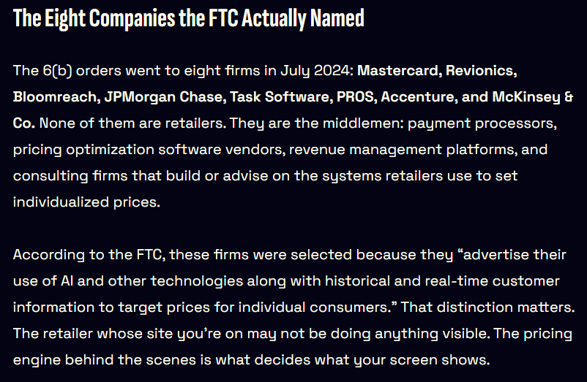
Shifting Regulatory Landscape
The FTC issued 6(b) orders to eight major companies in 2024 to study "surveillance pricing" practices
US Senate Banking Committee demanded answers from Amazon and Walmart on their use of "so-called dynamic pricing"
Multiple US states have begun passing algorithmic pricing disclosure laws in 2025–2026
gizmodo.com

Slide 31
Algorithmic Pricing Disclosure Laws
New York's Algorithmic Pricing Disclosure Act requires
  "THIS PRICE WAS SET BY AN ALGORITHM USING YOUR PERSONAL DATA“
Connecticut's law requires a "readily visible" disclosure whenever personal data raises a price
  "THIS PRICE WAS INCREASED USING YOUR PERSONAL DATA“ (or similar)
Many other states have passed or have pending laws

Slide 32
Algorithmic Collusion
Multiple competitors may feed data into the same third-party pricing algorithm
  As alleged with RealPage in rental housing
Independent pricing can turn into coordinated price-fixing
Firms must audit whether shared vendors/algorithms create (possibly unintended) anticompetitive outcomes
DOJ's case against RealPage treats algorithmic rent-setting software as a potential price-fixing scheme when it aggregates competitors' private data to recommend prices
This goes beyond individual firm behavior

Slide 33
Framing
Consider two identical outcomes for the same product:
  Frame A: "Your price is $120" (a different, higher posted price than another shopper's $100)
  Frame B: "You get a $20 discount" vs. another shopper's "$40 discount" (both start from a $140 list price)
Personalized discounts (coupons, first-visit offers, loyalty rewards) are viewed more positively
A personalized higher price for the identical product feels like discrimination or exploitation
Framing effect!

Slide 34
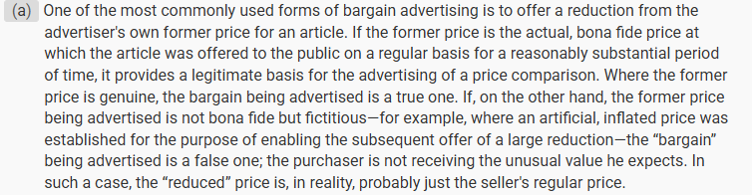
Framing (contd.)
Consumers assume a "fair" reference price exists
  A discount respects that reference price,
  A different price violates it (unfair!)
Algorithm pricing disclosure laws (Connecticut, NJ) specifically target situations where dynamic pricing increases a price
Also,
ecfr.gov

Slide 35
Recommendations
See “The Price is Right” article
Map and track collection and use of data for pricing decisions
Establish policies around what data are permitted for pricing decisions
Test for unintended biases of pricing data and algorithms
Provide clear disclosure to consumers about how data informs pricing
Ensure that personalized discounts exist in relation to real baseline prices
Implement stronger safeguards around pricing for essential products
Ensure alignment on pricing-related policies with vendors

Slide 36

firm and consumer outcomes
This Photo by Unknown Author is licensed under CC BY-SA-NC
This Photo by Unknown Author is licensed under CC BY-SA-NC

Slide 37
Firm Side
Dubé & Misra (2023) work with ZipRecruiter to conduct experiments
They train a ML model on the data
Raising the uniform prices increases profits by 55% (but lowers conversion)
Dynamic (personalized) pricing gives an additional 19% profit increase
For ZipRecruiter, the biggest profit gain came from optimizing the uniform price
Personalization helps too but effect smaller
Some firms may prefer growth over profits
Is the potential backlash worth it?

Slide 38

Consumer Side
Total consumer surplus declines under dynamic pricing relative to the optimized uniform price
But, more than 60% of individual consumers are better off
Some consumers (with higher willingness-to-pay) pay more
Many others (with lower willingness-to-pay) pay less
This Photo by Unknown Author is licensed under CC BY
Does dynamic pricing help those with lower WTP or exploit those with higher WTP?

Slide 39

exercise
This Photo by Unknown Author is licensed under CC BY-SA-NC

Slide 40
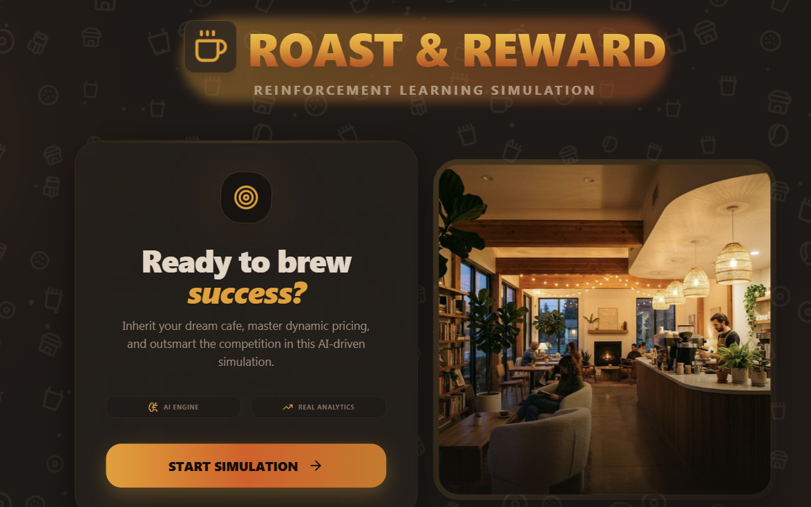

Slide 41
Introduction to the Simulation:
Roast & Reward Game
Simulation Overview
Act as a coffee shop owner making daily pricing decisions
Objective
Maximize:
Profit
Net rewards
Inventory efficiency
Learning Approach
Experimentation
Observation
Reflection
Adaptation

Slide 42
Structure of the
Simulation Environment
21-Day Decision Process
Each day includes:
Day of week, weather, inventory level, event presence, competitor presence & pricing
Player Action
Choose the daily price of coffee between $1 and 10
Goal
Maximize rewards,
Learn Policy
ML-suggested price is provided to help you

Slide 43
Exercise
Play the game (play as many times as you want)
Can you beat the RL algorithm?
How did you learn during the game?
What prompted your learning?
Did you explore or exploit? How did you transition?
Optionally, take the quiz
Prepare a presentation (max. 2 slides)

Slide 44
Next Week
Recess
AI Customer Interactions
  California Management Review
    Chatbot Frustration Is Real: Hidden Costs and Best Practices
  Harvard Business Review
    Fixing Chatbots Requires Psychology, Not Technology
  Microsoft Copilot Blog
    Building Reliable Voice Agents: A Practical Guide
  McKinsey Explainers
    Yee, Lareina et al. “What Is Retrieval-Augmented Generation (RAG)?”

Slide 45
Thank you for your attention

